Slide 1
Scaling Machine Learning with tensorflow
JIAli cheng
Sicheng zhang

Slide 2
What is Machine learning
Using examples to answer questions
Training : examples
Prediction: answer questions

Slide 3
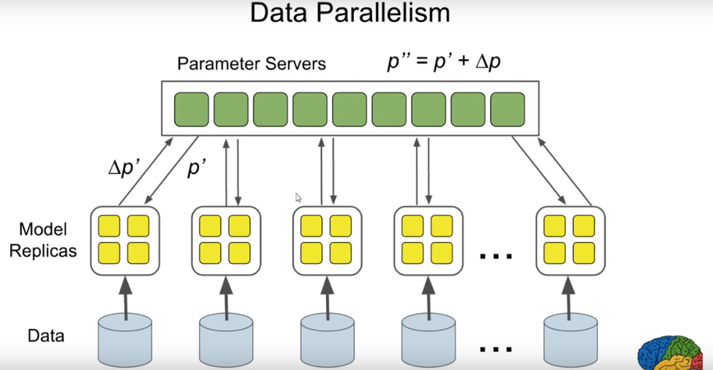
What is scaling ML
Facing Large data set which involving huge training instances, features or classes
Approach
Algorithms
MapReduce, BigTable, Spanner
Flume, Pregel
Open-resource:
Hadoop, HBase, Cassandra, Giraph

Slide 4
Why scale Machine learning
Process large data
Computational challenge
Improve performance
Natural language understanding and knowledge representation
Machine translation
Question answering
Large-scale unsupervised learning

Slide 5
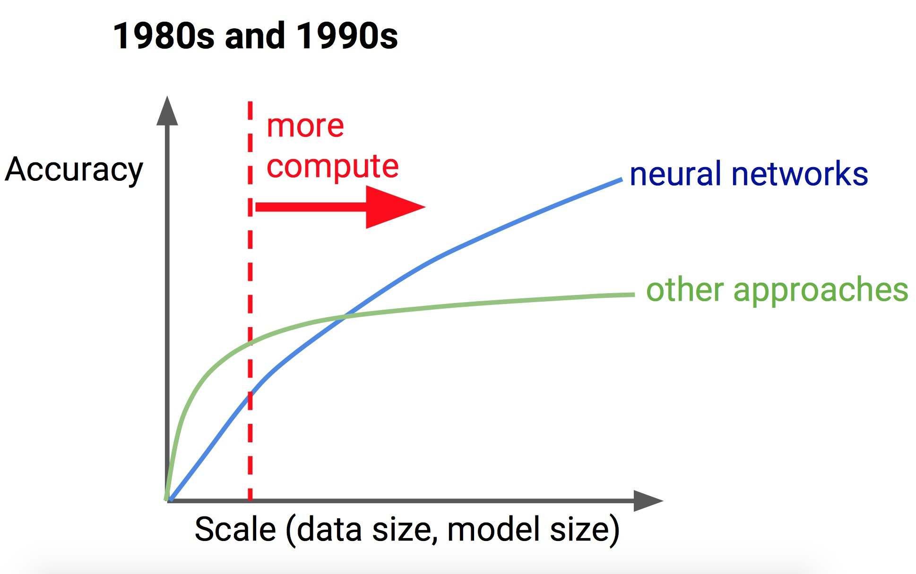
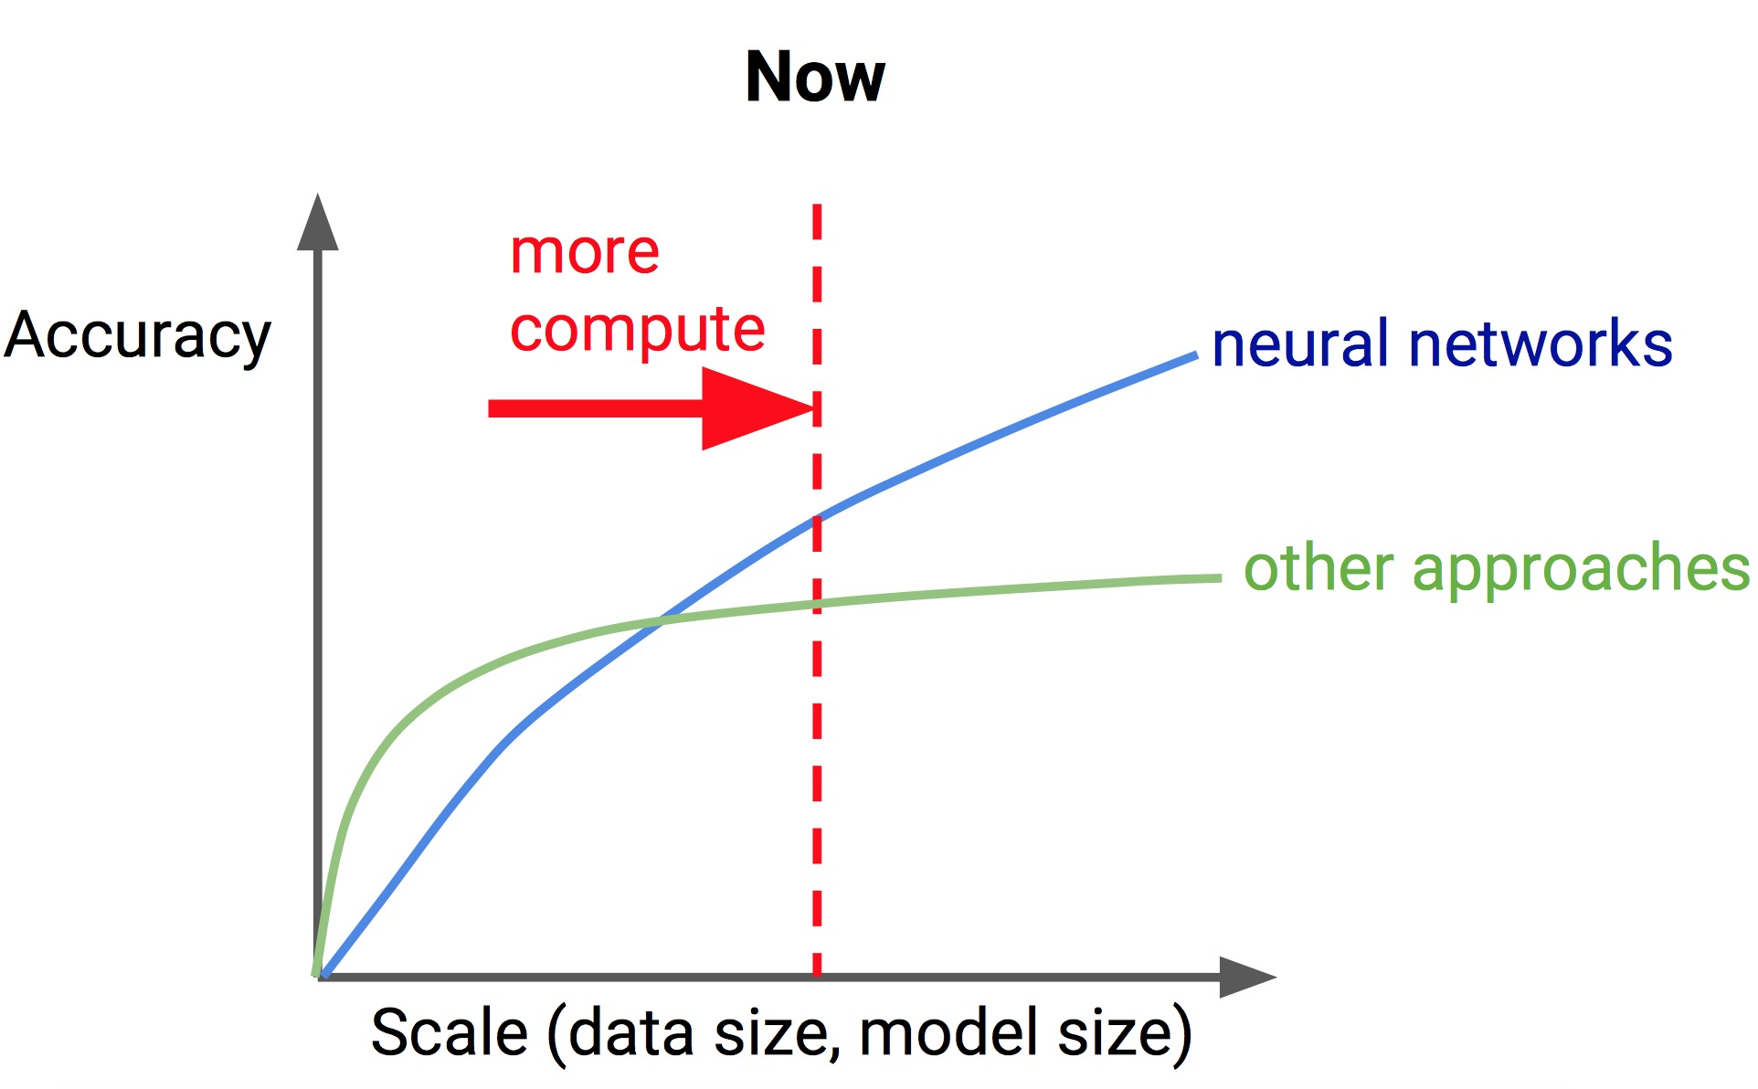
Compare by time

Slide 6
How to scale
Approach
MapReduce & GPU
Scale algorithms to much bigger data set
Stochastic gradient descent
Mini-batch gradient descent
Difficulties
Communication
Synchronization
I/O

Slide 7
Map Reduce
MapReduce is a programming model and an associated implementation for processing and generate big data sets with a parallel, distributed algorithm on a cluster
Mainly two function – Map() & Reduce()
Map : filtering sorting
Reduce : summary operation

Slide 8
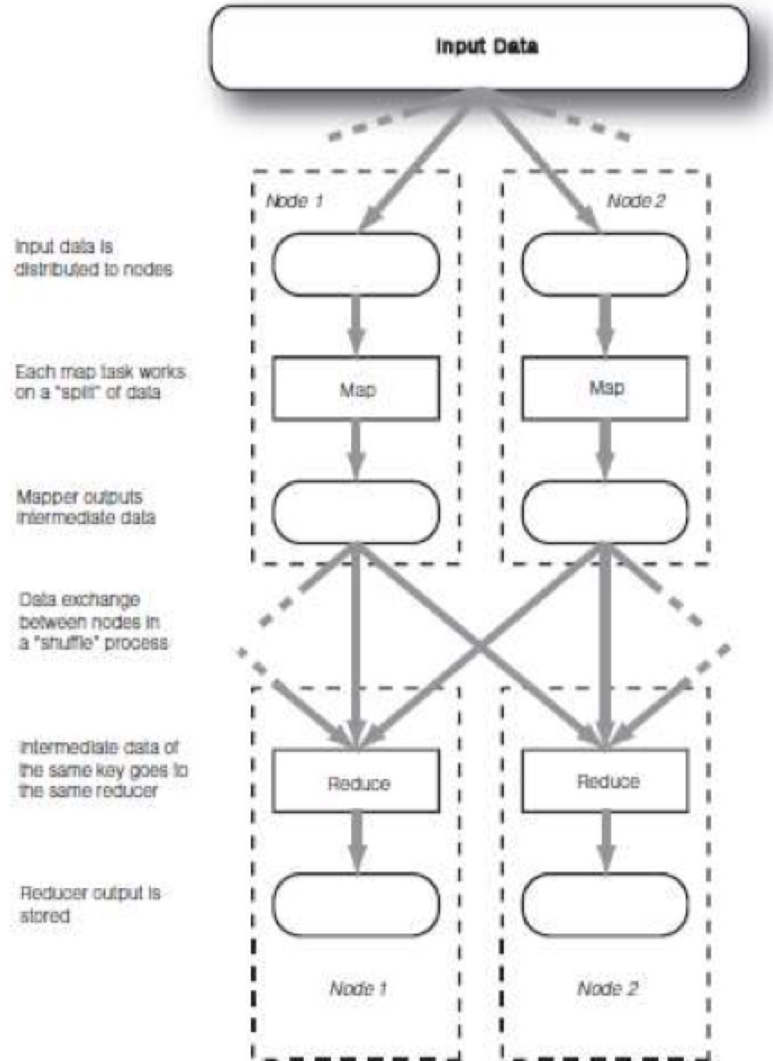

Slide 9
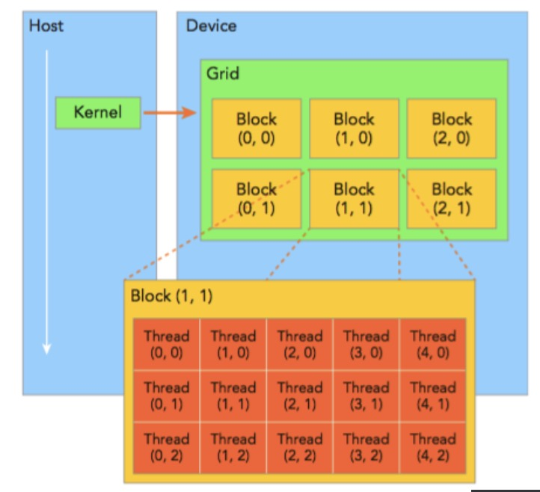
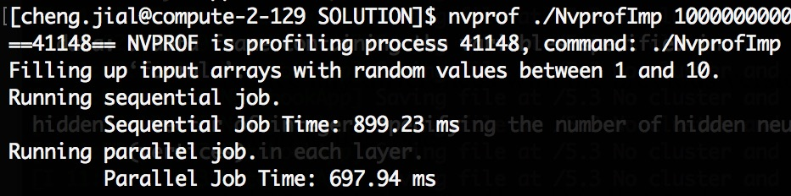
GPU
Blocks & threads

Slide 10
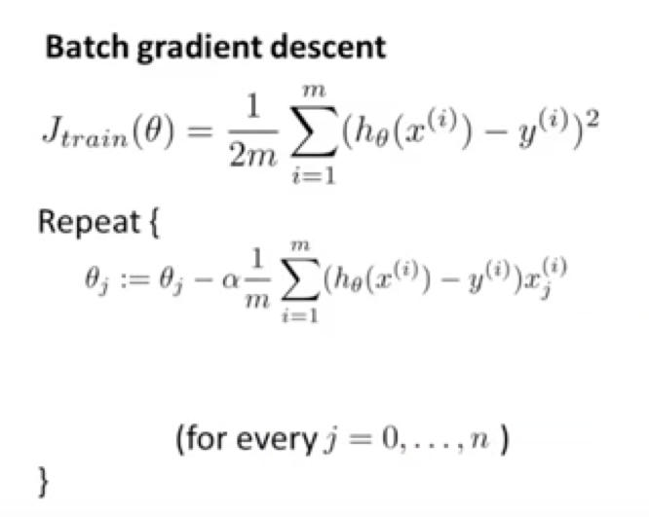
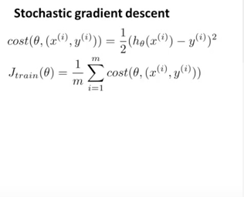
Stochastic gradient decent
Linear regression with gradient decent

Slide 11
Summary
Batch gradient descent : Use all examples in each iteration
Stochastic gradient descent :Use 1 example in each iteration

Slide 12
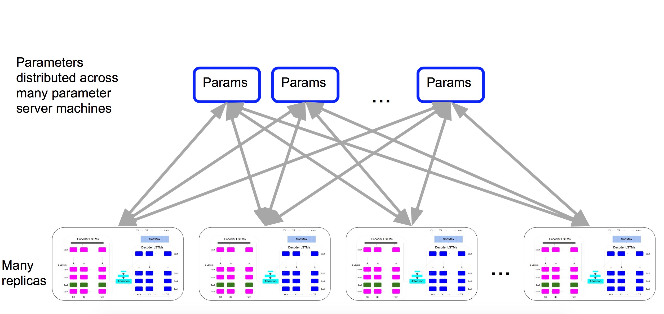
LSML examples : TensorFlow

Slide 13
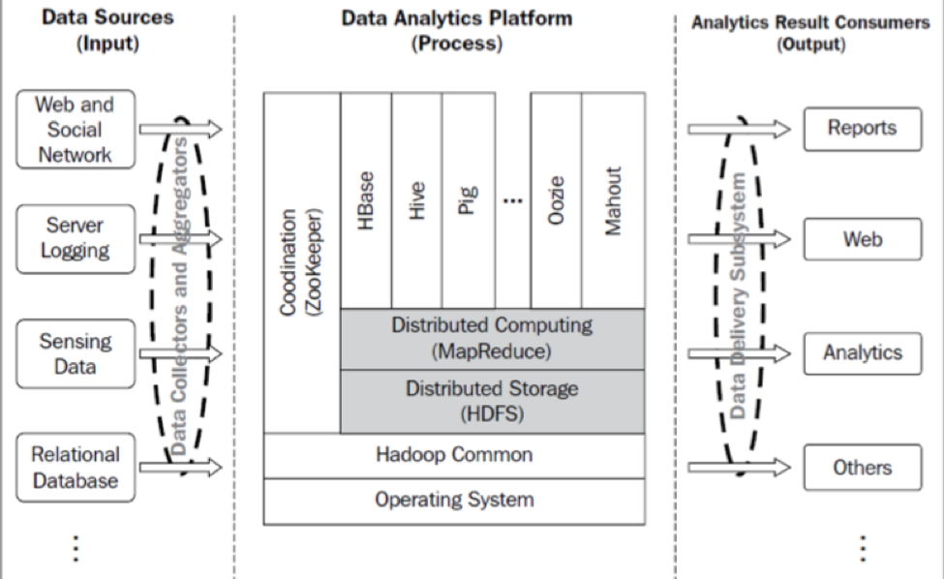
LSML examples : Hadoop

Slide 14
Tools when establish hadoop app
Hadoop Distribute File System (HDFS)
The parallel computing framework (MapReduce)
Common utilities
A column-oriented data storage table (HBase)
High-level data management systems (Pig and Hive)
Data analytics library (Mahout)

Slide 15
Tools when establish hadoop app
A distributed coordination system (ZooKeeper)
A workflow management module (Oozie)
Data transfer modules (such as Sqoop)
Data aggregation modules (such as flume)
Data serialization modules (such as avro)

